Slide 1
A Hidden Markov Model and Baum-Welch Algorithm
DATASCI 224 - Final Project Presentation
June 1st 2026
Wonhee Lee
Notes:
Hello, my name is Wonhee Lee.
In this project, I used a Hidden Markov Model (HMM) and the Baum–Welch algorithm to infer dynamic changes in diffusion states of molecule from single-particle tracking data.
Today, I will briefly introduce the motivation behind this approach and explain the underlying algorithm.

Slide 2
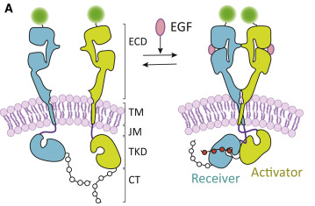
Membrane Protein Assembly is a Dynamic Process
(Biophysical Journal, 2020)
Notes:
As many of you learned in biochemistry, membrane proteins initiate cellular signaling by interacting with one another and forming molecular complexes.
Note that, these assembly and disassembly processes occur dynamically in real time.

Slide 3
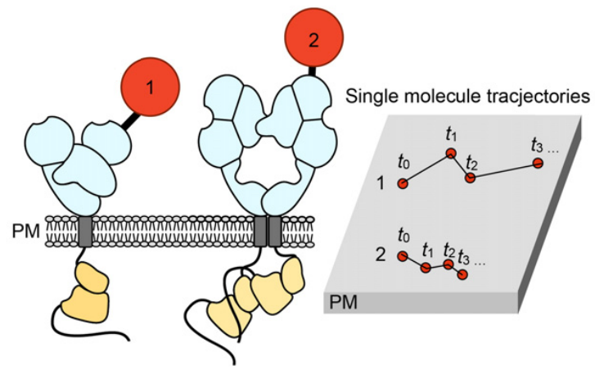
Diffusivity Reflects the Assembly States of Membrane Protein
Q. Can we infer the ‘dynamic’ assembly state of a membrane protein from its diffusion trajectory?
(Biochim Biophys Acta Biomembr, 2017)
Notes:
From a biophysical perspective, an interesting feature of membrane proteins is that their diffusivity depends on the size of the complexes.
For example, a protein in a monomeric state typically exhibits relatively fast diffusion, whereas dimerization increases its effective size and results in slower diffusion.
It leads to the following question: Can we infer the dynamic assembly state of a membrane protein from its diffusion trajectory?

Slide 4
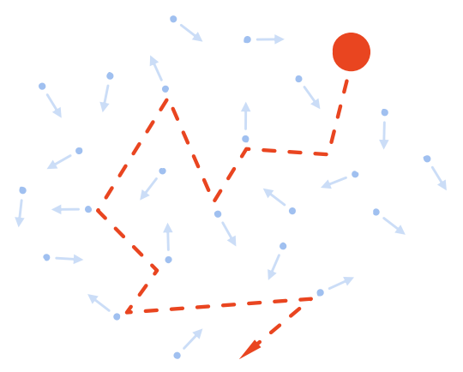
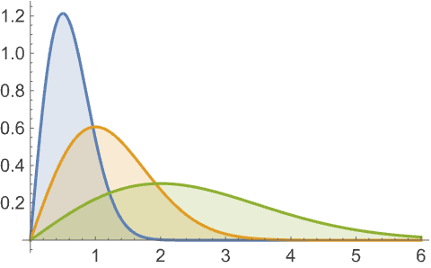
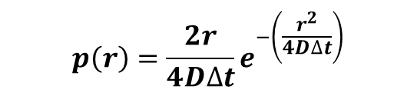
Physics of 2D Diffusion Behavior
p(r)
$$p\left(r\right)=\frac{2r}{4D∆t}e^{−\left(\frac{r^{2}}{4D∆t}\right)}$$
“r”
r
2D Brownian motion
Rayleigh Distribution
Notes:
Before answering this question, let me briefly introduce the diffusion model used in this study.
If r denotes the displacement of a molecule during a fixed time interval, then r follows a Rayleigh distribution under 2D Brownian diffusion.
The corresponding pdf and its shape are shown here.
One important feature of the Rayleigh distribution is that, unlike a symmetric Gaussian distribution, it is skewed toward zero.

Slide 5
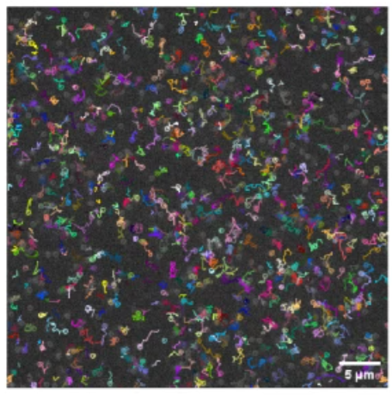
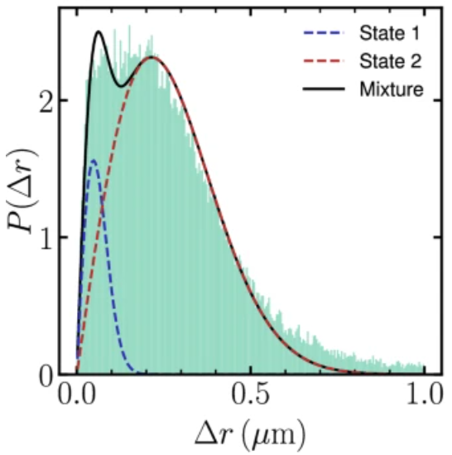
Problem: Jumping Distance Distributions of Diffusion Overlap A LOT!
Slow diffusive state?
Fast diffusive state?
Q. Can we infer the ‘dynamic’ assembly state of a membrane protein from its diffusion trajectory?
A. We need SMART methods!
(npj Biological Physics and Mechanics, 2026)
Notes:
The problem is, because of skewed shape of this distribution, the mixture model can strongly overlap.
Therefore, when a molecule switches between slow and fast diffusion states, it is difficult to determine whether a single jumping distance originated from the slow state or the fast state.
Therefore, we need a smarter inference method.

Slide 6
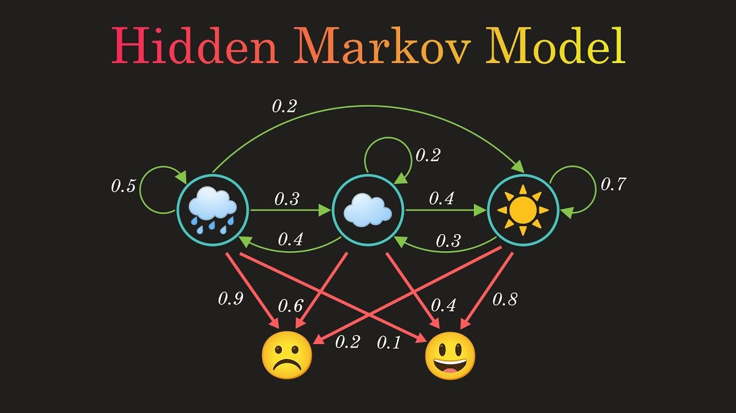
Why Hidden Markov Model (HMM) for Diffusion State Inference?
Notes:
One approach that has been proposed to address this challenge is the Hidden Markov Model (HMM).
Since the basic concepts and mathematical framework of HMMs were already introduced in the previous presentation, I will not go into the details here.

Slide 7

Why Hidden Markov Model (HMM) for Diffusion State Inference?
Complex Black Box Model in the Real World
?
Generation
Inference
☀️☀️☀️☁️☁️🌧️🌧️🌧️🌧️🌧️☁️☀️
Hidden states
😃😃😃☹️😃☹️☹️☹️☹️😃😃☹️
Observed data

Slide 8
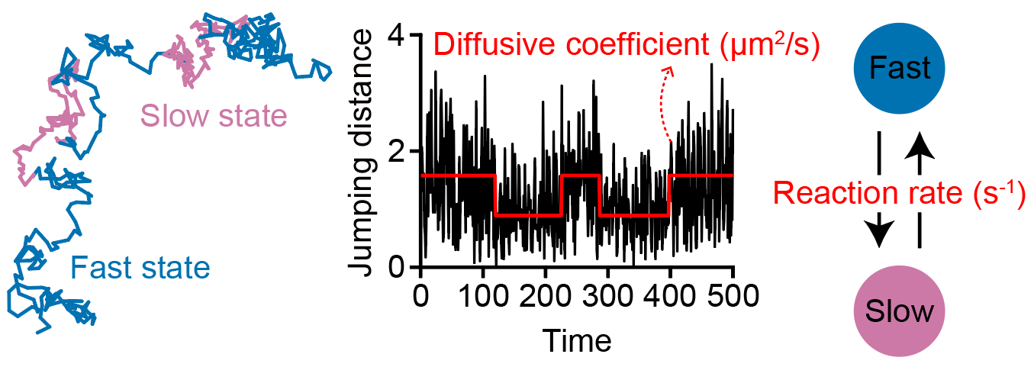
Why Hidden Markov Model (HMM) for Diffusion State Inference?
A sequence of observations
A hidden Layer of HMM
Oligomerization
“The hidden Markov model of diffusion”
Notes:
What I want to emphasize is that the HMM is particularly well suited for this problem because its structure closely matches the underlying biology.
Membrane proteins stochastically transition between hidden assembly states, such as monomers, dimers, and oligomers, each of which exhibits distinct diffusion behavior.
While these molecular states cannot be observed directly, their diffusion trajectories provide indirect evidence of the underlying state transitions.

Slide 9
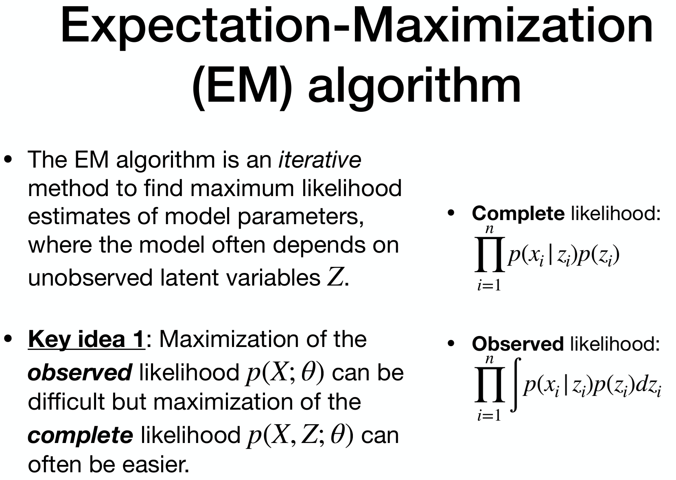
Overview of EM Algorithm
Z
☀️☁️
X
😃☹️
Notes:
HMM parameters are typically learned using the EM algorithm.
While defining and maximizing the observed-data likelihood is difficult, the complete-data likelihood becomes much easier to handle if the hidden states were known.

Slide 10
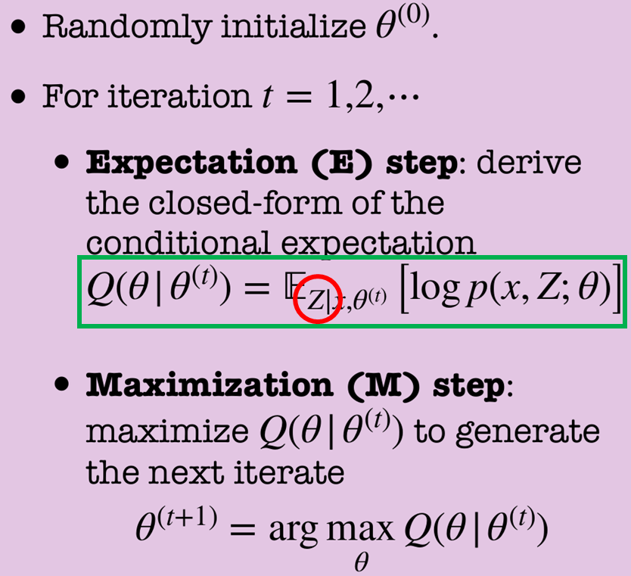
Overview of EM Algorithm
Foward-Backward Algorithm
Notes:
To do that, we first need the probability distribution of the latent variable Z, since the EM algorithm maximizes the expectation of log-likelihood.
In HMMs, the Forward–Backward algorithm, which combines the forward and backward algorithms, is used to estimate the posterior probabilities of hidden states.

Slide 11
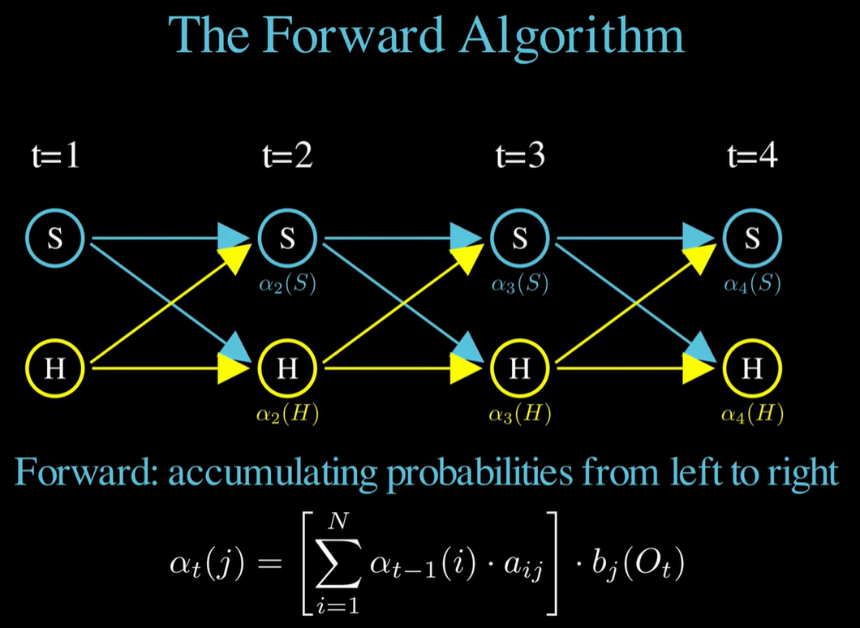
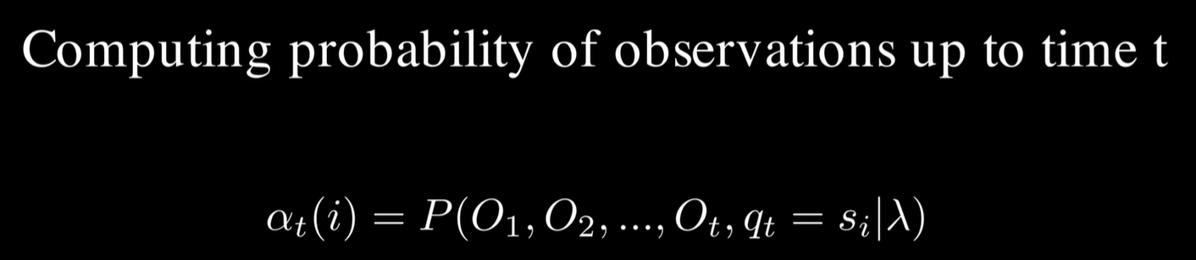

https://www.youtube.com/watch?v=QBDvFVmpgd0
$$α_{1}\left(k\right)=π_{k}p\left(r_{1}\left|D_{k}\right.\right)$$
Recursively
Notes:
The forward algorithm computes the probability of observing the trajectory up to time n and ending in state k, denoted by alpha.
The key idea is that this probability can be computed recursively using a from here and b from here, rather than by considering all possible state sequences.
Note that alpha can be initialized as shown here.

Slide 12
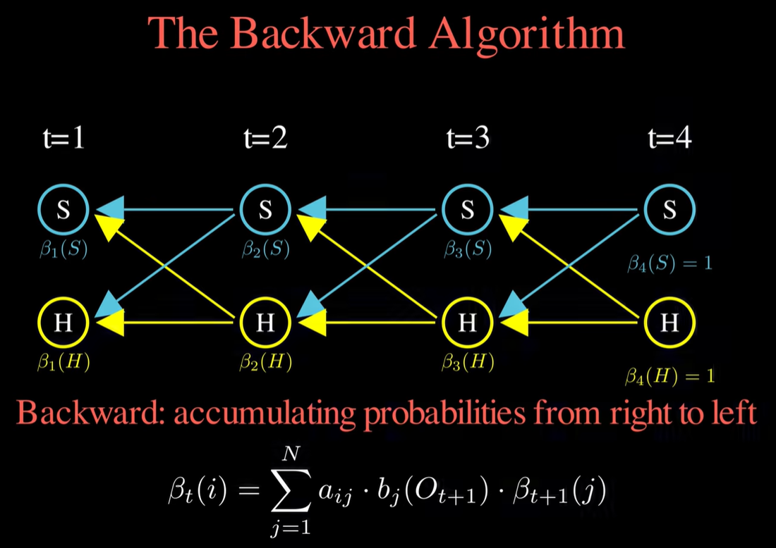
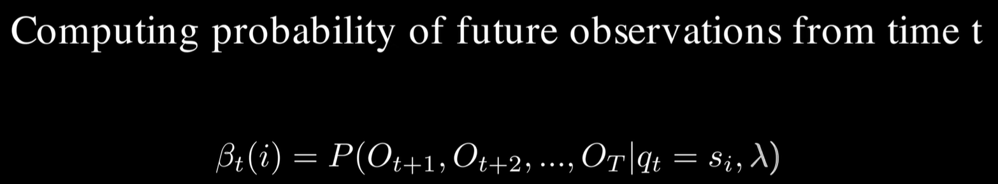

https://www.youtube.com/watch?v=QBDvFVmpgd0
$$β_{N}\left(k\right)=1$$
Recursively
Notes:
The backward algorithm computes the probability of observing the future part of the trajectory, assuming the system is currently in state k, denoted by beta.
It can also be computed recursively using a and b, but in the reverse direction.
Note that beta can be initialized as shown here.

Slide 13
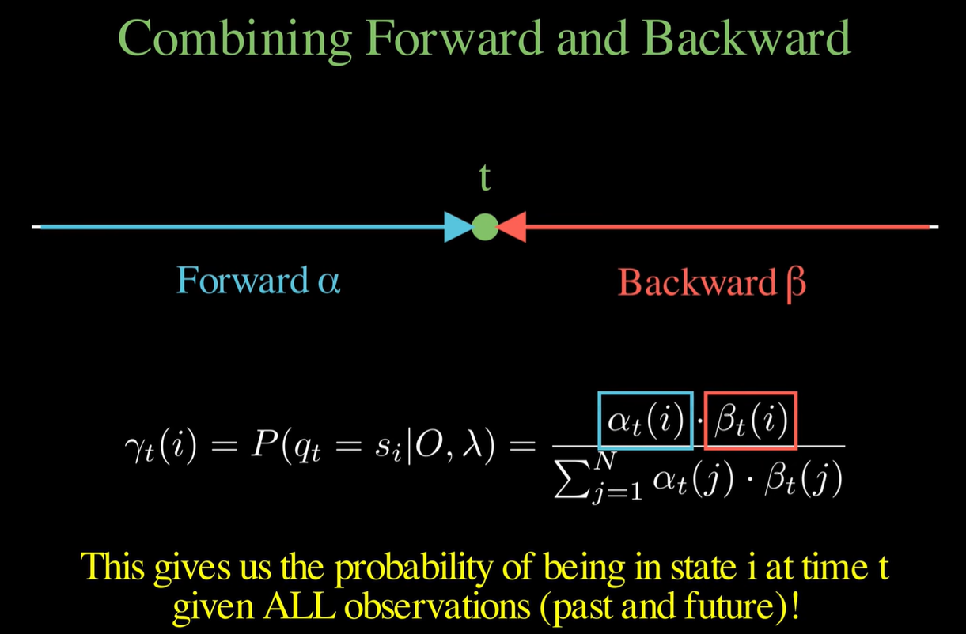
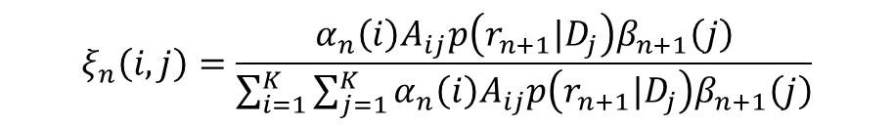
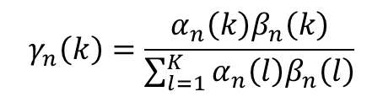
https://www.youtube.com/watch?v=QBDvFVmpgd0
“Forward-Backward Algorithm”
$$γ_{n}\left(k\right)=\frac{α_{n}\left(k\right)β_{n}\left(k\right)}{\sum_{l=1}^{K}{α_{n}\left(l\right)β_{n}\left(l\right)}}$$
$$ξ_{n}\left(i,j\right)=\frac{α_{n}\left(i\right)A_{ij}p\left(r_{n+1}|D_{j}\right)β_{n+1}\left(j\right)}{\sum_{i=1}^{K}{\sum_{j=1}^{K}{α_{n}\left(i\right)A_{ij}p\left(r_{n+1}|D_{j}\right)β_{n+1}\left(j\right)}}}$$
Probability of being in state k at time n
Probability of transitioning state i → j at time n → n+1
Notes:
The beauty of the forward–backward algorithm becomes apparent when we combine the two quantities.
By multiply alpha and beta and normalizing it to obtain a probability distribution, we can estimate the posterior probability of each hidden state using the entire trajectory, denoted by gamma.
Also, posterior probability of transition rate between states can also be computed by similar way, denoted by ksi.

Slide 14
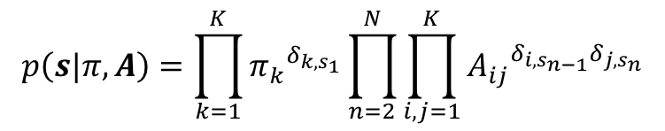

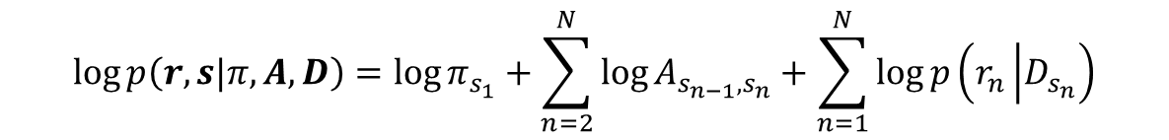
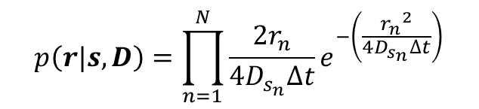
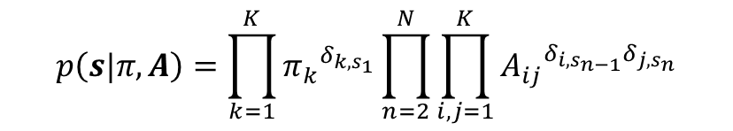
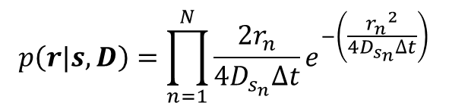
Define probability of ‘state transition at hidden layer’ and ‘diffusion’
$$p\left(s|π,A\right)=\prod_{k=1}^{K}{{π_{k}}^{δ_{k,s_{1}}}}\prod_{n=2}^{N}{\prod_{i,j=1}^{K}{{A_{ij}}^{δ_{i,s_{n−1}}δ_{j,s_{n}}}}}$$
$$p\left(r,s|π,A, D\right)=p\left(s|π,A\right)∙p\left(r|s,D\right)$$
$$\log{p\left(r,s|π,A, D\right)}=\log{π_{s_{1}}}+\sum_{n=2}^{N}{\log{A_{s_{n−1},s_{n}}}}+\sum_{n=1}^{N}{\log{p\left(r_{n}\left|D_{s_{n}}\right.\right)}}$$
$$p\left(r|s,D\right)=\prod_{n=1}^{N}{\frac{2r_{n}}{4D_{s_{n}}∆t}e^{−\left(\frac{{r_{n}}^{2}}{4D_{s_{n}}∆t}\right)}}$$
Taking logs
$$p\left(s|π,A\right)=\prod_{k=1}^{K}{{π_{k}}^{δ_{k,s_{1}}}}\prod_{n=2}^{N}{\prod_{i,j=1}^{K}{{A_{ij}}^{δ_{i,s_{n−1}}δ_{j,s_{n}}}}}$$
$$p\left(r|s,D\right)=\prod_{n=1}^{N}{\frac{2r_{n}}{4D_{s_{n}}∆t}e^{−\left(\frac{{r_{n}}^{2}}{4D_{s_{n}}∆t}\right)}}$$
𝜋: initiation probability
A: transition probability matrix
D: diffusion coefficient
Notes:
Okay, now we are ready to dive into the detailed EM algorithm for HMM.
The complete-data likelihood of the HMM can be decomposed into two components: the transition behavior of the hidden states and the jumping-distance distribution.
The objective function can be obtained by taking the logarithm of this likelihood and can be expressed as follows.

Slide 15

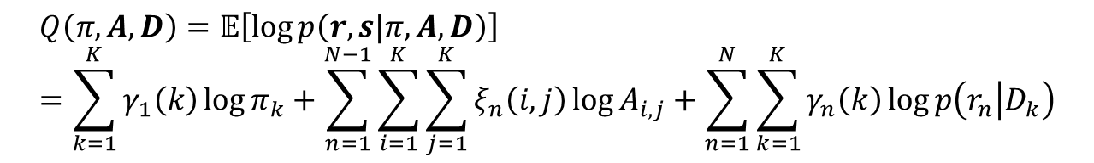
Define probability of ‘state transition at hidden layer’ and ‘diffusion’
$$p\left(s|π,A\right)=\prod_{k=1}^{K}{{π_{k}}^{δ_{k,s_{1}}}}\prod_{n=2}^{N}{\prod_{i,j=1}^{K}{{A_{ij}}^{δ_{i,s_{n−1}}δ_{j,s_{n}}}}}$$
$$p\left(r,s|π,A, D\right)=p\left(s|π,A\right)∙p\left(r|s,D\right)$$
$$\log{p\left(r,s|π,A, D\right)}=\log{π_{s_{1}}}+\sum_{n=2}^{N}{\log{A_{s_{n−1},s_{n}}}}+\sum_{n=1}^{N}{\log{p\left(r_{n}\left|D_{s_{n}}\right.\right)}}$$
$$p\left(r|s,D\right)=\prod_{n=1}^{N}{\frac{2r_{n}}{4D_{s_{n}}∆t}e^{−\left(\frac{{r_{n}}^{2}}{4D_{s_{n}}∆t}\right)}}$$
Taking logs
Expectation
$$Q\left(π,A,D\right)=𝔼\left[\log{p\left(r,s|π,A, D\right)}\right]=\sum_{k=1}^{K}{γ_{1}\left(k\right)\log{π_{k}}}+\sum_{n=1}^{N−1}{\sum_{i=1}^{K}{\sum_{j=1}^{K}{ξ_{n}\left(i,j\right)\log{A_{i,j}}}}}+\sum_{n=1}^{N}{\sum_{k=1}^{K}{γ_{n}\left(k\right)\log{p\left(r_{n}\left|D_{k}\right.\right)}}}$$
Compute with an old parameter set
E-step
Partial derivatives equal to zeros
$π_{k,new}= γ_{1}\left(k\right)$
$A_{ij,new}=\frac{\sum_{n=1}^{N−1}{ξ_{n}\left(i,j\right)}}{\sum_{n=1}^{N−1}{γ_{n}\left(i\right)}}$
$D_{k,new}=\frac{\sum_{n=1}^{N}{γ_{n}\left(k\right){r_{n}}^{2}}}{4∆t\sum_{n=1}^{N}{γ_{n}\left(k\right)}}$
“Baum-Welch Algorithm”
to learn HMM parameters
M-step
“Viterbi Algorithm”
to decode the most likely hidden states
Update
Notes:
With initial prior distribution of latent variables, expectation of the objective function Q can be expressed like this.
To maximize Q with respect to the model parameters π, A, and D, we can take the partial derivatives of Q with respect to each parameter and set them equal to zero.
This gives closed-form update for HMM parameters in terms of gammas and ksis.
In practice, the algorithm alternates between two steps.

Slide 16
Define probability of ‘state transition at hidden layer’ and ‘diffusion’
$$p\left(s|π,A\right)=\prod_{k=1}^{K}{{π_{k}}^{δ_{k,s_{1}}}}\prod_{n=2}^{N}{\prod_{i,j=1}^{K}{{A_{ij}}^{δ_{i,s_{n−1}}δ_{j,s_{n}}}}}$$
$$p\left(r,s|π,A, D\right)=p\left(s|π,A\right)∙p\left(r|s,D\right)$$
$$\log{p\left(r,s|π,A, D\right)}=\log{π_{s_{1}}}+\sum_{n=2}^{N}{\log{A_{s_{n−1},s_{n}}}}+\sum_{n=1}^{N}{\log{p\left(r_{n}\left|D_{s_{n}}\right.\right)}}$$
$$p\left(r|s,D\right)=\prod_{n=1}^{N}{\frac{2r_{n}}{4D_{s_{n}}∆t}e^{−\left(\frac{{r_{n}}^{2}}{4D_{s_{n}}∆t}\right)}}$$
Taking logs
Expectation
$$Q\left(π,A,D\right)=𝔼\left[\log{p\left(r,s|π,A, D\right)}\right]=\sum_{k=1}^{K}{γ_{1}\left(k\right)\log{π_{k}}}+\sum_{n=1}^{N−1}{\sum_{i=1}^{K}{\sum_{j=1}^{K}{ξ_{n}\left(i,j\right)\log{A_{i,j}}}}}+\sum_{n=1}^{N}{\sum_{k=1}^{K}{γ_{n}\left(k\right)\log{p\left(r_{n}\left|D_{k}\right.\right)}}}$$
Compute with an old parameter set
E-step
Partial derivatives equal to zeros
$π_{k,new}= γ_{1}\left(k\right)$
$A_{ij,new}=\frac{\sum_{n=1}^{N−1}{ξ_{n}\left(i,j\right)}}{\sum_{n=1}^{N−1}{γ_{n}\left(i\right)}}$
$D_{k,new}=\frac{\sum_{n=1}^{N}{γ_{n}\left(k\right){r_{n}}^{2}}}{4∆t\sum_{n=1}^{N}{γ_{n}\left(k\right)}}$
“Baum-Welch Algorithm”
to learn HMM parameters
M-step
“Viterbi Algorithm”
to decode the most likely hidden states
Update
Notes:
In the E-step, the posterior probabilities gamma and ksi are computed using the current parameter estimates.
In the M-step, the model parameters π, A, and D are updated according to the closed-form update equations.
These two steps are repeated iteratively until the objective function Q converges.
This iterative EM procedure for HMMs is known as the Baum–Welch algorithm.
Since the Viterbi algorithm for state decoding was already covered in the previous presentation, I will skip the details here.

Slide 17
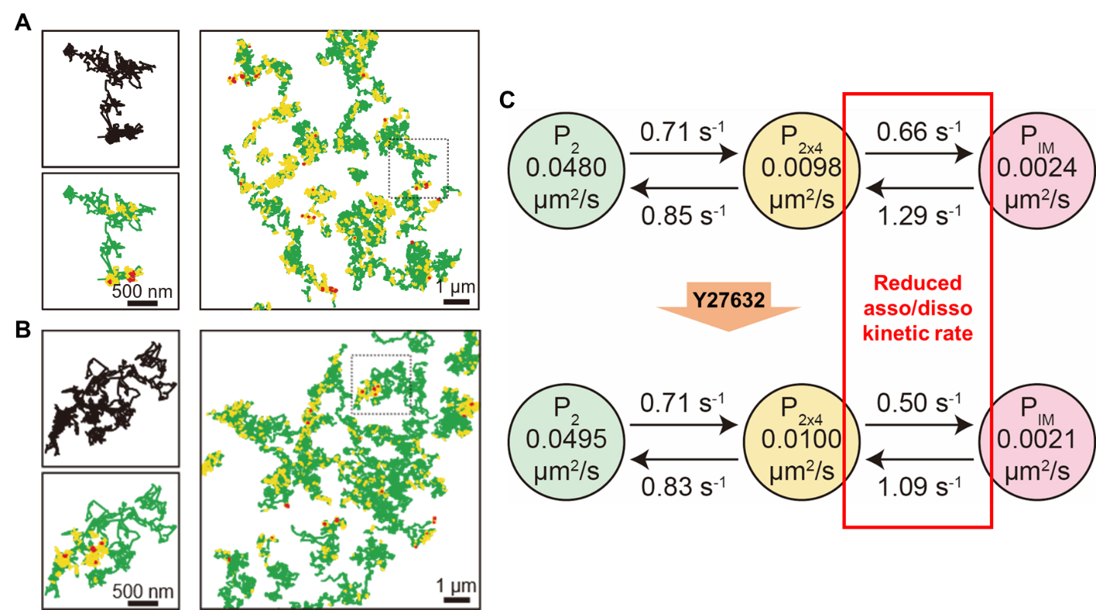
A: transition probability matrix
D: diffusion coefficient
𝜋: initiation probability (doesn’t matter in general)
Notes:
Using this framework, I analyzed single-particle tracking data of membrane proteins called PLVAP.
From the estimated transition probability matrix, I got the transition dynamics between different diffusive states.
In addition, the emission probabilities allowed me to estimate the diffusion coefficient associated with each hidden diffusive state.
That concludes my presentation and I'd be happy to take any questions.

